Slide 1

Data Science Introduction
Eng. Amira Fouda

Slide 2

Data All Around

Slide 3


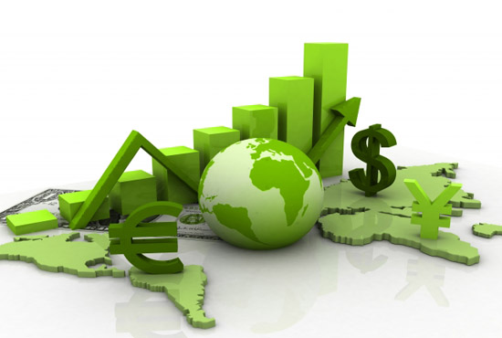

Data All Around
Lots of data is being collected and warehoused
Web data, e-commerce
Financial transactions, bank/credit transactions
Online trading and purchasing
Social Network

Slide 4

How Much Data Do We have?
Every day 2.5 quintillion bytes of data has been created
Generation Statistics show that more than 500 terabytes of new data are entered into the databases of the social networking site Facebook every day.
A single Jet engine can generate over 10 terabytes of data in 30 minutes of flight time.
Stock Exchange is also an example of big data that generates about a terabyte of new trade data per day

Slide 5
Big Data
Big Data is any data that is expensive to manage and hard to extract value from
Volume
The size of the data
Velocity
The latency of data processing relative to the growing demand for interactivity
Variety and Complexity
the diversity of sources, formats, quality, structures.

Slide 6
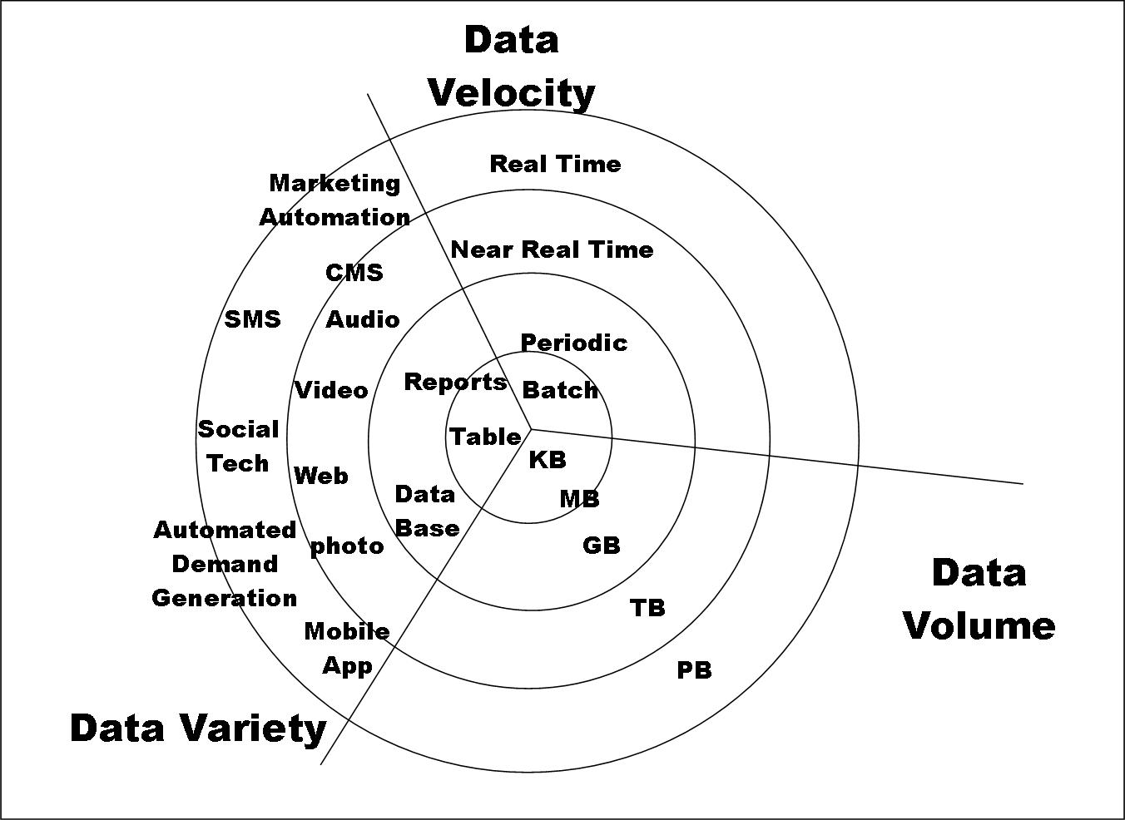
Big Data

Slide 7
Types of Data We Have:
Relational Data
(Tables/Transaction/Legacy Data)
Text Data (Web)
Semi-structured Data (XML)
Graph Data
Social Network, Semantic Web (RDF), …
Streaming Data
Notes:
1- It's structured data represented in rows and columns, where each row represents a record and each column represents an attribute or field.
2- including web pages, documents, articles, social media posts, emails, etc. This data may be unstructured.
3- often used for representing hierarchical data with tags to denote the structure and meaning.
4- Graph data represents relationships between entities through nodes and edges.
5- Resource Description Framework) is a standard model for representing and linking data on the web, particularly useful for expressing metadata and relationships between resources.
6- Streaming data refers to continuously generated data that is processed in real-time or near real-time. This type of data is often produced by sensors, IoT devices, social media feeds, etc.

Slide 8
What To Do With These Data?
Knowledge
discovery
Aggregation and Statistics
Indexing, Searching
& Querying
Notes:
Data mining is the process of discovering patterns, correlations, and trends within large datasets to extract useful information and insights.

Slide 9
Data Science

Slide 10
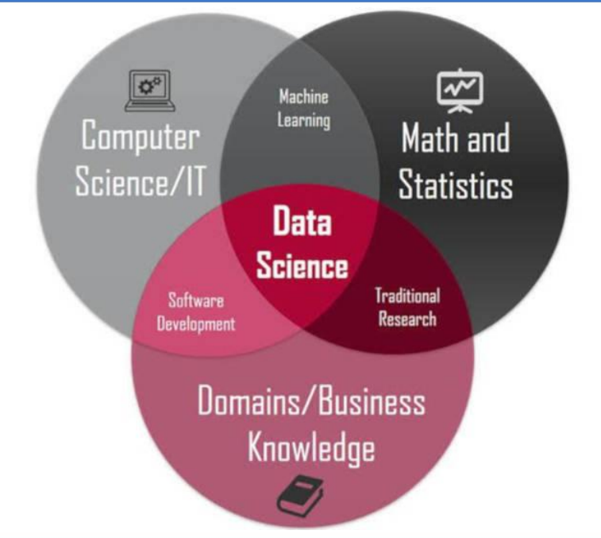
Data Science is an interdisciplinary field that uses algorithms, procedures, and processes to examine large amounts of data in order to uncover hidden patterns, generate insights, and direct decision making.

Slide 11
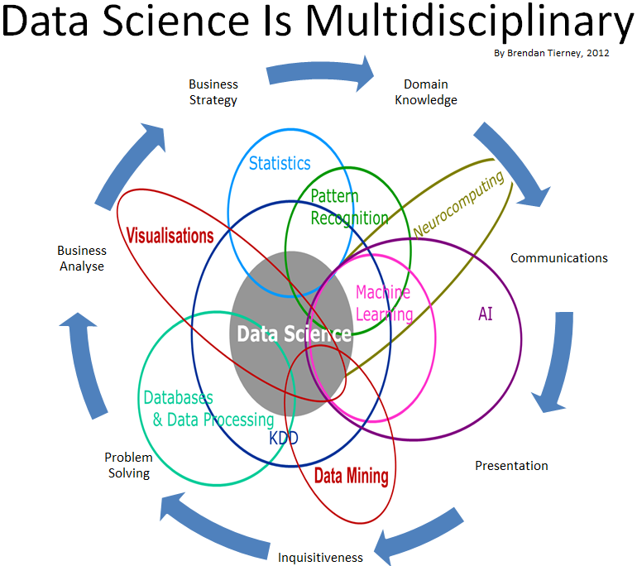

Slide 12

Career Opportunities

Slide 13
Career Opportunities
“The rise of Data Science needs will create roughly 11.5 million job openings by 2026" US Bureau of Labour Statistics “By 2026, Data Scientists and Analysts will become the number one emerging role in the world." World Economic Forum Data Science and Artificial Intelligence are amongst the hottest fields of the 21st century that will impact all segments of daily life by 2025, from transport and logistics to healthcare and customer service.

Slide 14

Importance of Data Science

Slide 15
Importance of Data Science
Data science helps brands to understand their customers in a much enhanced and empowered manner.
It allows brands to communicate their story in such an engaging and powerful manner.
Big Data is anew field that is constantly growing and evolving.
Its findings and results can be applied to almost any sector like travel, healthcare and education among others.
Data science is accessible to almost all sectors

Slide 16
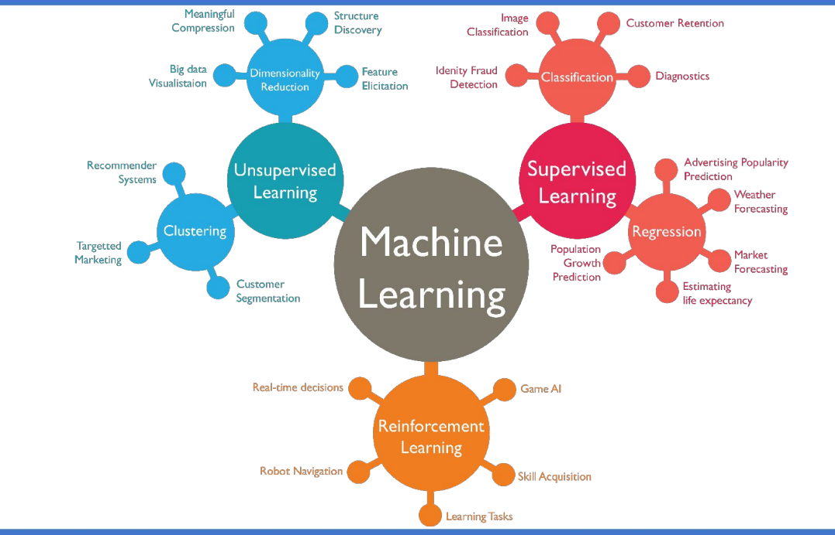
Types of Machine Learning

Slide 17
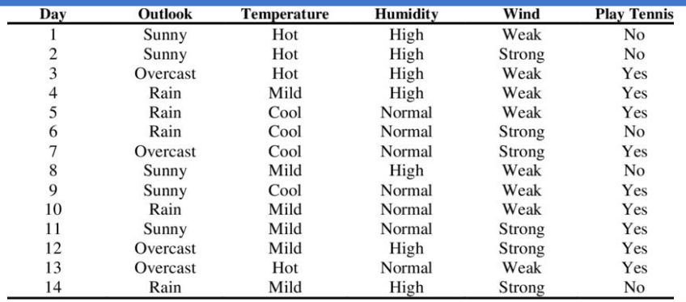
Data Set

Slide 18

Applications of Data Science

Slide 19
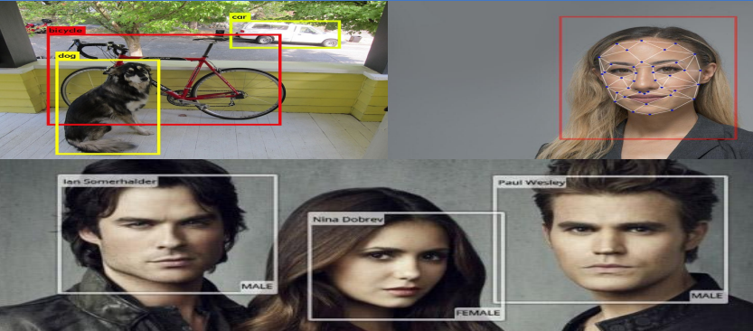
Computer Vision Application

Slide 20
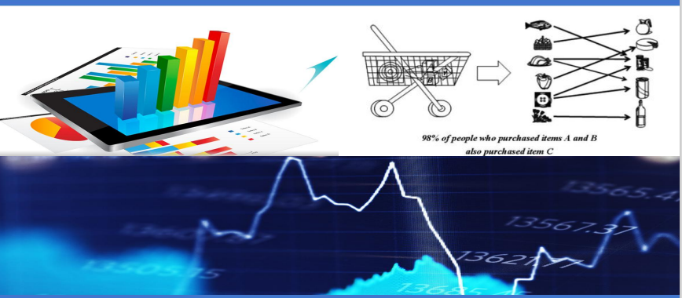
Economics Application

Slide 21
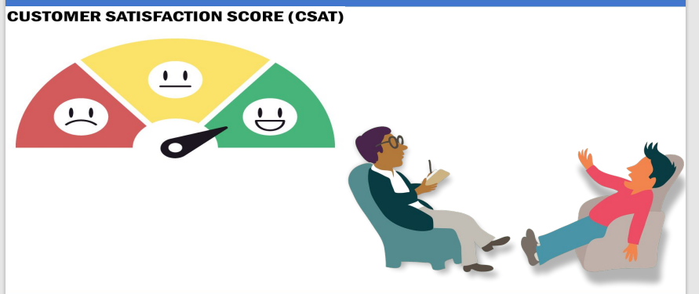
Sentiment analysis Application

Slide 22

Recommendation Sys. Application

Slide 23
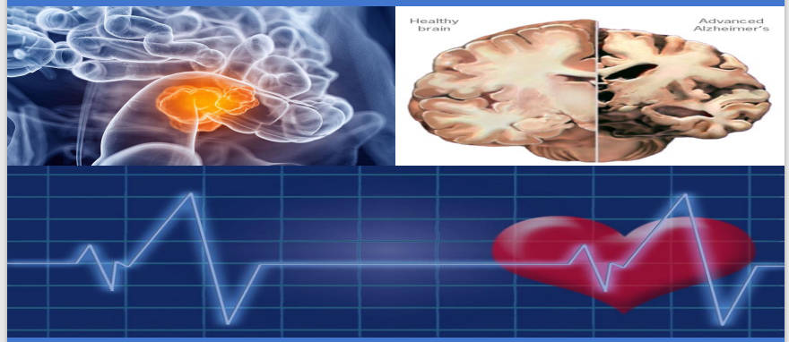
Medical Diagnosis Applications

Slide 24
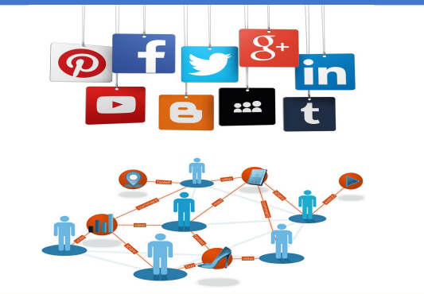
Online Advertising Platforms

Slide 25
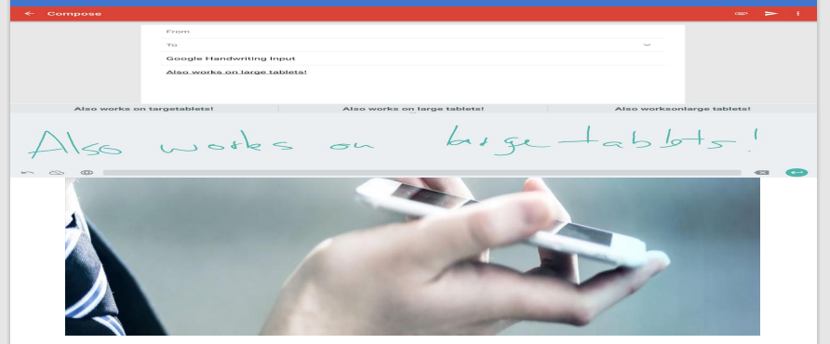
Speech & Hand Writing Recognition

Slide 26
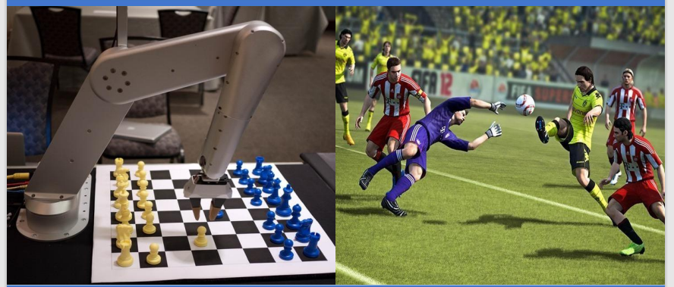
Playing Game

Slide 27

Robotics & Personal Assistants

Slide 28

Price Comparison websites

Slide 29
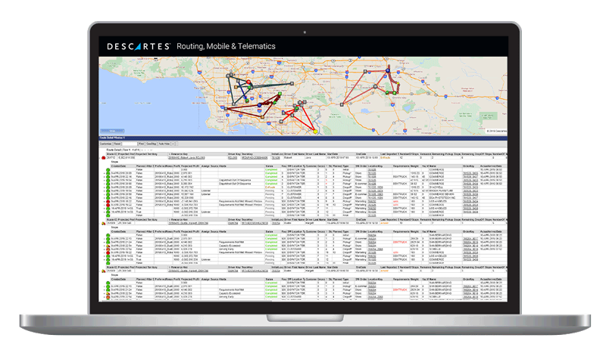
Airline Routing Planning

Slide 30

Fraud and Risk Detection

Slide 31

HealthCare

Slide 32
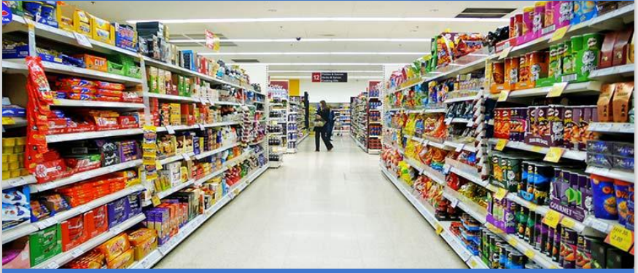
Supermarket

Slide 33
How does Data Science Work?
Actionable insights that will serve as a solution for the business problems gathered through data science.
Raw data is gathered from various sources that explain the business problem
Collect Data
Insights
Analyze Data
Using various statistical analysis, and machine learning approaches, data modeling is performed to get the optimum solutions that best explain the business problem

Slide 34
Consider an Example!
Suppose there is an organization that is working towards finding out potential leads for their sales team. They can follow the following approach to get an optimal solution using Data Science
01
Collect Data
03
02
Analysis Data
Insights
Notes:
1- Gather the previous data on the sales that were closed.
2- Use statistical analysis to find out the patterns that were followed by the leads that were closed.
3- Use machine learning to get actionable insights for finding out potential leads.

Slide 35
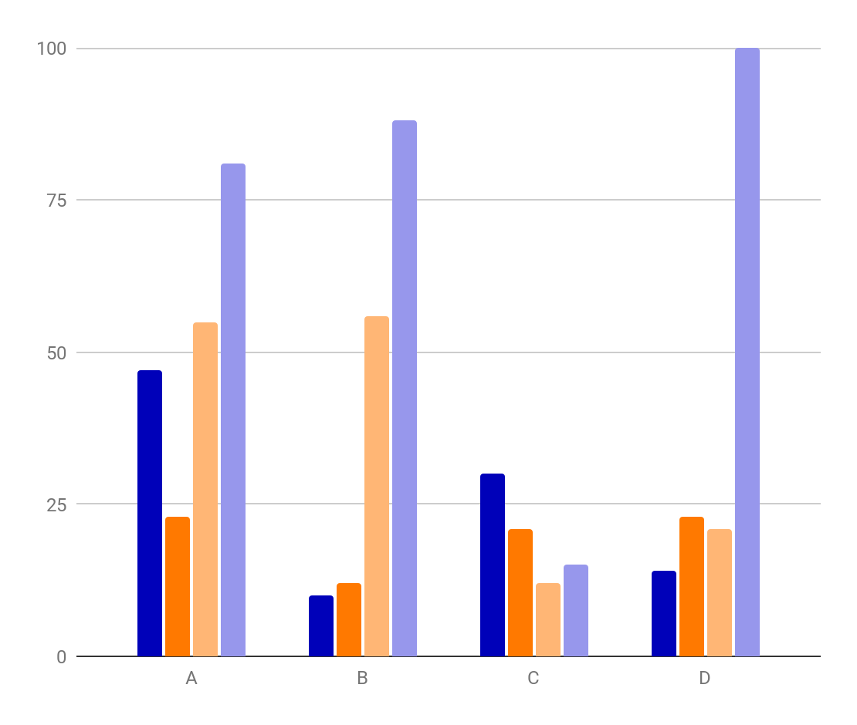
Data Science is a science which uses:
Computer Science
Machine Learning
Statistics
Visualization
Human Computer Interaction
To collect, clean, integrate, analyze, visualize, interact with data to create data product

Slide 36
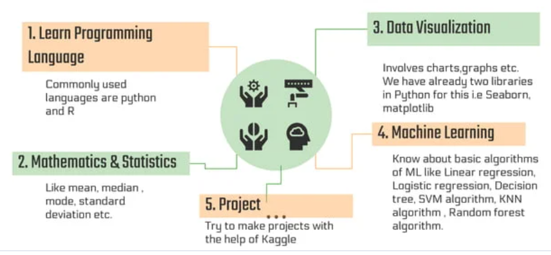
Roadmap of Data Science

Slide 37
Thanks!
Do you have any questions?

